Slide 1
TRAINING PRESENTATION
Gerald Jan Balverde

Slide 2
AGENDA
Basic and Advance SQL

Slide 3

What is SQL?
Structured Query Language is the standard language used for relational database management systems (RDBMS). What is RDBMS? A database management system that manages data as a collection of tables in which all relationships are represented by common values in related tables

Slide 4
Basics
Of SQL

Slide 5

DATA MANIPULATION LANGUAGE(DML)
This manipulation involves inserting data into database
tables, retrieving existing data, deleting data from existing
tables and modifying existing data.

Slide 6
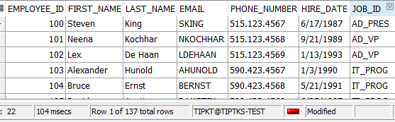
Select
SELECT statement is used to retrieve records from one or more tables in your SQL database. The records retrieved are known as a RESULT SET.
SYNTAX:
SELECT (column) FROM (table)
SELECT DISTINCT | COLUMN NAME | COLUMN ALIAS | ARITHMETIC EXPRESSIONS | || {CONCAT} | LITERALS
FROM
Ex.
SELECT employee_id,
First_name,
Last_name,
Email,
Phone_number
Hire_date
Job_id
FROM employees;

Slide 7
INSERT
INSERT statement is used to insert a one or more records into a table.
7
SYNTAX:
INSERT INTO table (column1, column2, ... )
VALUES (expression1, expression2, ... );
Ex.
insert into MyCustomers(customer_id,
customer_username,
customer_password )
values
(
1,
‘Gerald',
‘316428'
);
<- These parameters are optional if you want to encode a specific row value, otherwise encode all values

Slide 8
UPDATE
UPDATE statement is used to update existing records in the tables.
SYNTAX:
UPDATE table
SET column1 = expression1, column2 = expression2
[WHERE conditions];
Ex.
UPDATE MyCustomers
SET status = 'logged out'
WHERE customer_username = 'gerbal’;
<- Remove the WHERE clause if you want to update all values of columns in SET clause

Slide 9
DELETE
9
DELETE statement is a used to delete one or more records from a table.
SYNTAX:
DELETE FROM table [WHERE conditions];
Ex.
DELETE FROM MyCustomers
WHERE customer_username = 'gerbal’;
<- Removing this WHERE clause will delete all rows

Slide 10
Data definition language (DDL)
definition language (DDL) is a computer language used to create and modify the structure of database objects in a database. These database objects include views, schemas, tables, indexes, etc.

Slide 11
CREATE
11
CREATE TABLE statement allows you to create and define a table.
SYNTAX:
CREATE TABLE table_name ( column1 datatype Constraint
column2 datatype Constraint
Ex.
CREATE TABLE MyCustomers
(
customer_id number(10) PRIMARY KEY ,
customer_username varchar2(50) UNIQUE NOT NULL,
customer_password varchar2(50) NOT NULL,
date_created date default sysdate;
<- Blue is Constraint
^ Red is data type

Slide 12
ALTER
ADD A COLUMN

Slide 13
ALTER
ADD A COLUMN
MODIFY A COLUMN
ALTER TABLE MyCustomers
ADD status varchar2(10) DEFAULT 'logged out'
ALTER TABLE MyCustomers
MODIFY customer_id number(10)
ADD A MULTIPLE COLUMN
MODIFY A MULTIPLE COLUMN
ALTER TABLE table_name
ADD (column_1 datatype Constraint ,
column_2 datatype Constraint ,
column_3 datatype Constraint );
ALTER TABLE table_name
MODIFY (column_1 column_definition,
column_2 column_definition,
column_n column_definition);

Slide 14
DROP A COLUMN
ALTER TABLE MyCustomers
DROP COLUMN customer_id (ne need for data type)
RENAME A COLUMN
ALTER TABLE MyCustomers
RENAME COLUMN customer_id to ID
RENAME A TABLE
ALTER TABLE MyCustomers
RENAME TO CustomersNiGerb

Slide 15
DROP
DROP TABLE statement allows you to remove or delete a table from the Oracle database.
SYNTAX:
DROP TABLE [schema_name].table_name
^ schema name is optional
DROP TABLE MyCustomers

Slide 16
TRUNCATE
TRUNCATE TABLE statement is used to remove all records from a table in Oracle. It performs the same function as a DELETE statement without a WHERE clause.
TRUNCATE TABLE [schema_name.]table_name
^ schema name is optional
TRUNCATE TABLE MyCustomers

Slide 17
COMMENT
These comments can appear on a single line or span across multiple lines.
Symbol:
-- (double dash)
--select * from mycustomers
/* */
/*
CREATE TABLE MyCustomers
(
customer_id number(10) PRIMARY KEY ,
customer_username varchar2(500) UNIQUE NOT NULL,
customer_password varchar2(500) NOT NULL,
date_created date default sysdate NOT NULL,
no_of_transactions number default 0 not null
);
*/

Slide 18
CONCATINATION
SYNTAX:
SELECT COLUMN/’text’ || COLUMN/’text’ || COLUMN/’text’ AS ALIAS
FROM TABLE
<- Separated by double pipe ||
SELECT first_name || ' with last name of ' || last_name AS "FULL NAME"
FROM employees
SYNTAX:
SELECT CONCAT(COLUMN/’text’, COLUMN/’text’) AS ALIAS
FROM TABLE
<- Only accepts 2 parameters unless you use concat nesting
SELECT CONCAT(first_name, 'eyyyy') AS abccd
FROM employees

Slide 19
ALIAS
- Renames a column heading
Ex.
In SELECT clause
SELECT first_name AS pangalan,
FROM employees
Ex.
In FROM clause and WHERE clause
SELECT first_name,
department_name,
city,
country_name,
reg.climate_type
FROM employees emp,
departments dept,
locations loc,
countries country,
regions reg
WHERE EMP.DEPARTMENT_ID = DEPT.DEPARTMENT_ID and
DEPT.LOCATION_ID = LOC.LOCATION_ID and
LOC.COUNTRY_ID = COUNTRY.COUNTRY_ID and
COUNTRY.REGION_ID = REG.REGION_ID;
IN SELECT, AS is optional
Ex.
In SELECT clause
SELECT first_name pangalan,
last_name apelyido
FROM employees
CANNOT USE ALIAS OF COLUMN AS IDENTIFIER IN WHERE CLAUSE
SELECT city ciudad
FROM locations
WHERE ciudad = 'Roma'
USE “ “ when it has space, or case sensitive

Slide 20
WHERE CLAUSE
Used to limit the Rows That Are Selected

Slide 21
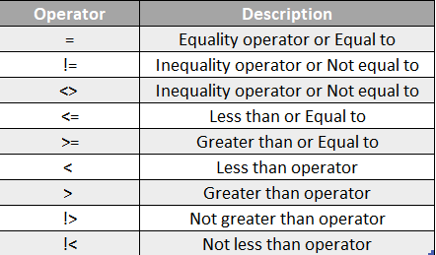
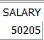
Comparison Operators

Slide 22
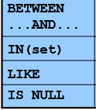
Comparison Operators
SELECT employee_id, first_name, salary as sweldo
FROM employees
WHERE not employee_id between 100 AND 150
SELECT *
FROM departments
WHERE location_id IN (1700, 2500, 2700)
SELECT city
FROM locations
WHERE city LIKE ‘_okyo’
SELECT city
FROM locations
WHERE city LIKE ‘T%’
SELECT *
FROM locations
WHERE city LIKE '%a'
SELECT *
FROM employees
WHERE first_name is null
SELECT *
FROM locations
WHERE city LIKE ‘%a%'
^ Can also add a NOT, IS NOT NULL

Slide 23
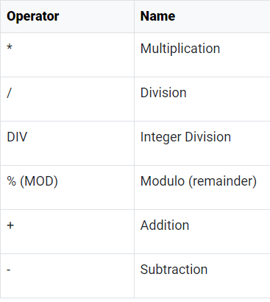
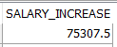
Arithmetic Operators
Arithmetic operators can be used in the SELECT, WHERE clauses. IT FOLLOWS PEMDAS
Ex.
In SELECT clause
SELECT salary + (salary * 0.5) AS salary_increase
FROM employees;
In WHERE clause
select first_name, last_name
from employees
where mod(salary, 2) = 1
--salary is odd number
^ (Power) | Raises one number by another number.

Slide 24
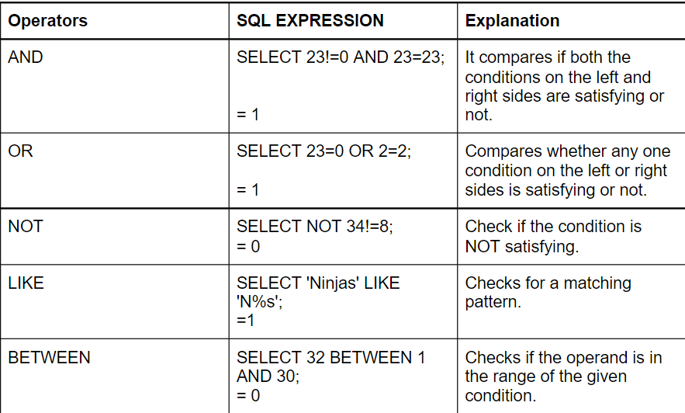
LogiCAL Operators
SELECT * FROM employees
WHERE customer_id = '10’ AND department_id = 80
SELECT *
FROM employees
WHERE job_id = 'IT_PROG' OR job_id = 'HR_REP'
SELECT *
FROM locations
WHERE NOT city = 'Roma'

Slide 25
NUMBER FUNCTIONS
ROUND(value, decimal place)
select round(210 + 250 * 2 / 3, 2) from dual;
TRUNC(value, decimal place to trim)
select trunc(210 + 250 * 2 / 3, 3) from dual;
MOD(dividend, divisor)
select MOD(100, 2) from dual;

Slide 26
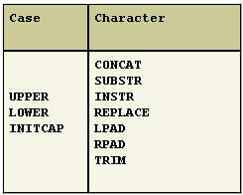
CASE & CHARACTER FUNCTIONS

Slide 27
CASE FUNCTIONS
LOWER() | Lower case all in parameter
SELECT LOWER (job_id)
FROM jobs
WHERE LOWER (job_id) = 'ad_vp'
w/ output
^ The value will depent on identifier
SELECT LOWER (job_id)
FROM jobs
WHERE job_id = 'ad_vp'
w/o output

Slide 28
CASE FUNCTIONS
UPPER() | Upper case all in parameter
SELECT UPPER (job_title)
FROM jobs
WHERE UPPER (job_title) = 'PRESIDENT'
w/ output
SELECT UPPER (job_title)
FROM jobs
WHERE job_title = 'PRESIDENT'
w/o output

Slide 29
CASE FUNCTIONS
INNITCAP() | Initialize the first letter in parameter
SELECT UPPER (job_title)
FROM jobs
WHERE UPPER (job_title) = 'PRESIDENT'
w/ output
SELECT UPPER (job_title)
FROM jobs
WHERE job_title = 'PRESIDENT'
w/o output

Slide 30
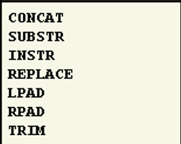
CHARACTER FUNCTIONS
TIP: Learn the parameters on each function
1st String value, 2nd Place of word, 3rd How many words will return
SUBSTR: SELECT SUBSTR (first_name, 2, 10) FROM employees
INSTR: SELECT first_name, INSTR (first_name, 'a') FROM employees
REPLACE: SELECT first_name, REPLACE (first_name, 'a', 'o’)
FROM employees
LPAD: SELECT min_salary, LPAD(min_salary, 2, '*’)
FROM jobs
RPAD: SELECT min_salary, RPAD(min_salary, 2, '*’)
FROM jobs
TRIM: SELECT TRIM( FROM 'HelloWorld') from dual
This only trim first and last word

Slide 31
AGGREGATE FUNCTIONS
AGGREGATE functions are used in SELECT and HAVING clause
COUNT()
SELECT COUNT (*)
FROM jobs
WHERE UPPER (job_title) = 'PRESIDENT'
SELECT SUM(*)
FROM jobs
WHERE UPPER (job_title) = 'PRESIDENT'
SUM()
AVG()
SELECT AVG (*)
FROM jobs
WHERE UPPER (job_title) = 'PRESIDENT'

Slide 32
AGGREGATE FUNCTIONS
AGGREGATE functions are used in SELECT and HAVING clause
MIN()
SELECT MIN (*)
FROM jobs
WHERE UPPER (job_title) = 'PRESIDENT'
SELECT MAX (*)
FROM jobs
WHERE UPPER (job_title) = 'PRESIDENT'
MAX()
AVG()
SELECT AVG (*)
FROM jobs
WHERE UPPER (job_title) = 'PRESIDENT'

Slide 33
JOINS
Combine tables

Slide 34
JOINS
Natural join
SELECT * FROM employees NATURAL JOIN departments
-- lahat ng common columns ay pinagsama

Slide 35
JOINS
Cross join
select * from employees cross join jobs
select * from employees, jobs
-- apply all jobs table to employee

Slide 36
JOINS
Join with USING clause
SELECT * FROM employees JOIN departments
USING (MANAGER_ID)
--kung ano ang manager_id sa departments, ibabangga sa matching manager id sa employees

Slide 37
JOINS
Join with ON clause
SELECT first_name,
department_name,
city,
country_name,
reg.climate_type
FROM employees emp
JOIN departments dept ON EMP.DEPARTMENT_ID = DEPT.DEPARTMENT_ID
JOIN locations loc ON DEPT.LOCATION_ID = LOC.LOCATION_ID
JOIN countries country ON LOC.COUNTRY_ID = COUNTRY.COUNTRY_ID
JOIN regions reg ON COUNTRY.REGION_ID = REG.REGION_ID
--with ON clause to connect with matching column from another table

Slide 38
JOINS
SELF JOIN
SELECT e.first_name emp, m.first_name mgr
FROM employees e JOIN employees m
ON (e.manager_id = m.employee_id);
Mind the on condition

Slide 39
JOINS
LEFT JOIN
select * from employees emp left join departments dep
on emp.department_id = dep.department_id
order by emp.department_id
select * from employees emp, departments dep
where emp.department_id = dep.department_id (+)
order by emp.department_id
Mind the on condition

Slide 40
JOINS
RIGHT JOIN
select * from employees emp right join departments dep
on emp.department_id = dep.department_id
order by emp.department_id
select * from employees emp, departments dep
where emp.department_id(+) = dep.department_id
order by emp.department_id
Mind the on condition

Slide 41
SUBQUERY
close it with parenthesis
In WHERE clause:
SELECT last_name, job_id
FROM employees
WHERE job_id = (SELECT job_id
FROM employees
WHERE last_name = 'Balverde');
<- The value of this subquery is ‘IT_PROG’
In FROM clause:
SELECT first_name, salary
FROM (SELECT employee_id,
first_name,
last_name,
salary
FROM employees
WHERE employee_id BETWEEN 100 AND 150)
<- The value of this subquery is table of employees with id between 100 and 150

Slide 42
SUBQUERY
close it with parenthesis
SELECT last_name, job_id
FROM employees
WHERE job_id = (SELECT job_id
FROM employees
WHERE last_name = 'Balverde');
<- The value of this subquery is ‘IT_PROG’

Slide 43




SET
UNION
UNION ALL
INTERSECT
MINUS

Slide 44
UNION
UNION operator removed duplicates between the result sets
A
B

Slide 45
UNION ALL
The UNION ALL operator returns results from both queries, including all duplications.
A
B

Slide 46
INTERSECT
A
B
The INTERSECT operator returns rows that are common to both queries.
A
B

Slide 47
MINUS
B
Minus returns only a data set on A, if a value appeared on both data set it will not show
A
B

Slide 48
Views
CREATE VIEW toView AS
SELECT * from MyCustomers

Slide 49
ORDER BY
SELECT employee_id, last_name, salary
FROM employees
ORDER BY salary ASC/DESC;
Sort by ASC/DESC
ALIAS can be used
SORT multiple columns

Slide 50
DISTINCT
Removes the duplicate in value of column
SELECT DISTINCT department_id
FROM employes

Slide 51
THANK YOU

